Slide 1
INT323 DATABASE ESSENTIALS TOWARDS INFORMATICA Lecture 0 ‘ Let’s move toward the better way to store and manage the data’

Slide 2
Marks criteria
Contributor | Marks
Attendance | 5
CA(1 best out of 2 and 3rd BYOD is compulsory) | 25
MTE(subjective) | 20
ETE(subjective) | 50

Slide 3
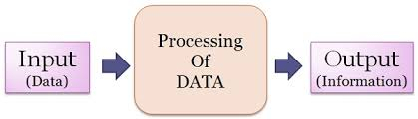
Data and information
Raw material that can be processed by any computing machine is data.
Images, words, numbers , sounds etc. all forms different representations of the data.

Slide 4
Database
A database is actually a place where related piece of information is stored and various operations can be performed on it.
Or we can say database is a shared collection of logically related data in a systematic manner that is stored to meet the requirements of different users of an organization that can be easily accessed.
Database can be maintained manually or through electronic devices such as digital diaries,mobile phones,computers etc.

Slide 5
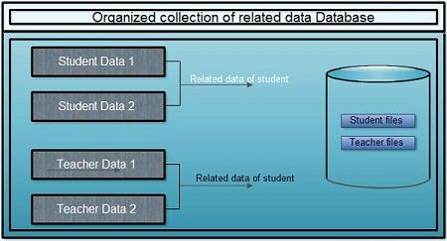
Database

Slide 6
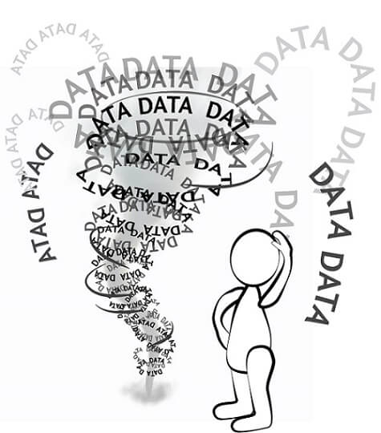
Unit 1: Digital Data and Bussiness Inteligence
Whenever you send an email, read a social media post, or take pictures with your digital camera, you are working with digital data. We all probably hear this term on a daily basis, but have you ever wondered what digital means?
If you think it means any electronic information on a computer, you are on the right track, but there is a bit more to it. Let's define digital data and take a look at how it is used in our daily lives.

Slide 7
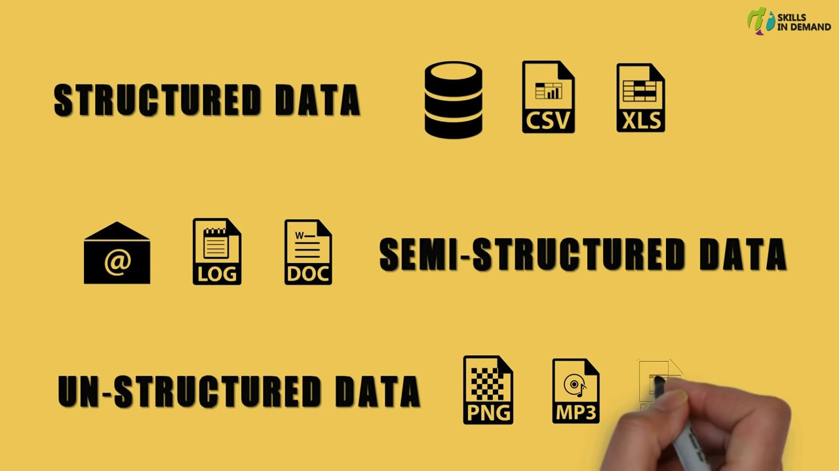
Types of Data

Slide 8
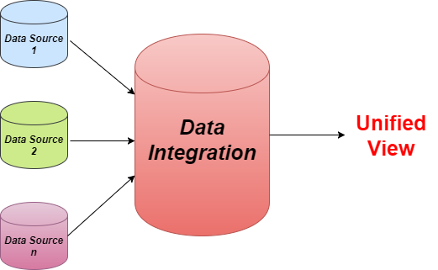
Unit 2: Data integration
Data Integration is a data preprocessing technique that combines data from multiple sources and provides users a unified view of these data.

Slide 9
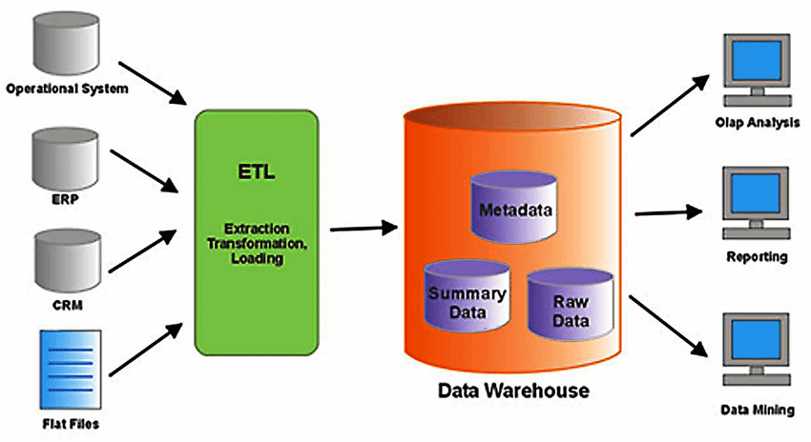
Unit 3: Data Warehouse

Slide 10
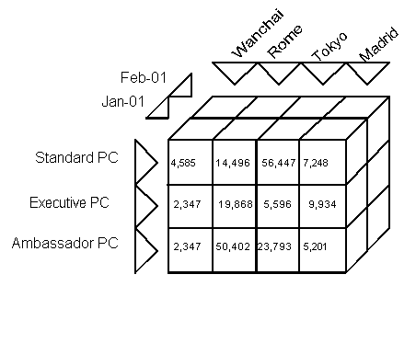
Unit 4: Multi-dimensional Data

Slide 11
Unit 5: ETL processing with Rapid Miner

Slide 12
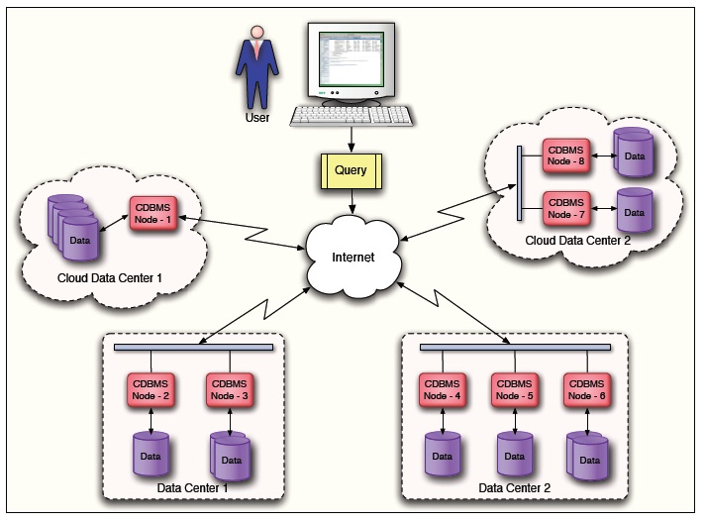
Unit 6: Cloud Databases

